Slide 1
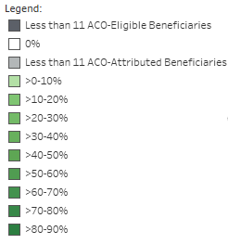
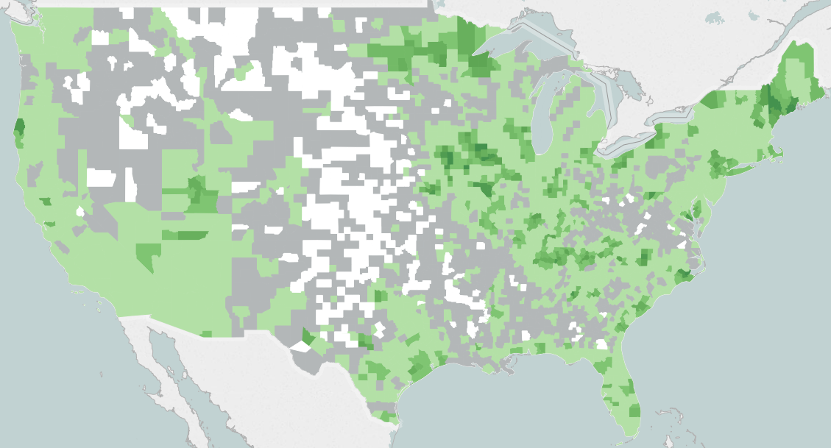
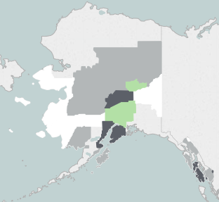
County Exposure to MSSP ACOs, 2012
Darker shades of green represent counties with a greater share of ACO-eligible beneficiaries assigned to an ACO. The shaded county is the area of residence on file for the beneficiary.
Dark gray shading represents counties with fewer than 11 ACO-eligible beneficiaries. Due to our data use agreement, we are unable to provide exposure rates for these counties.
White shading represents counties with no ACO-attributed beneficiaries.
Light gray shading represents counties with fewer than 11 ACO-attributed beneficiaries. Due to our data use agreement, we are unable to provide exposure rates for these counties.
Source: Dobson|DaVanzo analysis of 2012 VRDC RIF data, DUA #28643.

Slide 2
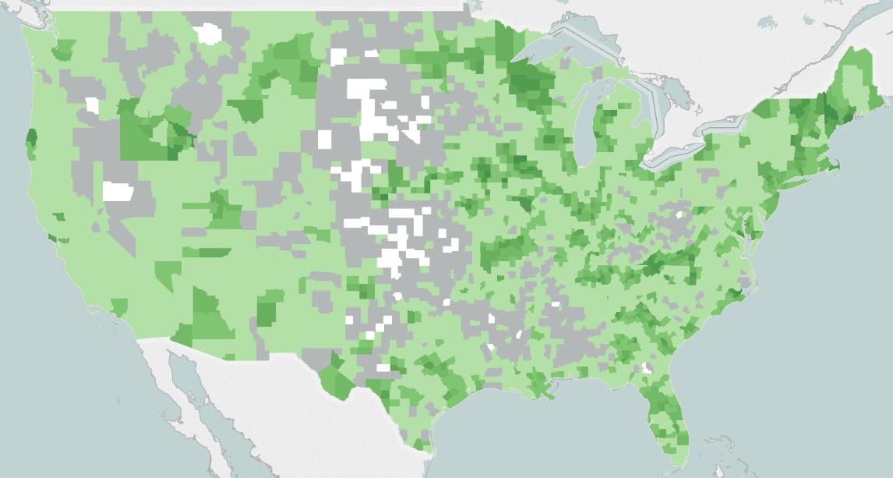
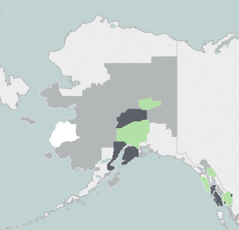
County Exposure to MSSP ACOs, 2013
Darker shades of green represent counties with a greater share of ACO-eligible beneficiaries assigned to an ACO. The shaded county is the area of residence on file for the beneficiary.
Dark gray shading represents counties with fewer than 11 ACO-eligible beneficiaries. Due to our data use agreement, we are unable to provide exposure rates for these counties.
White shading represents counties with no ACO-attributed beneficiaries.
Light gray shading represents counties with fewer than 11 ACO-attributed beneficiaries. Due to our data use agreement, we are unable to provide exposure rates for these counties.
Source: Dobson|DaVanzo analysis of 2013 VRDC RIF data, DUA #28643.

Slide 3
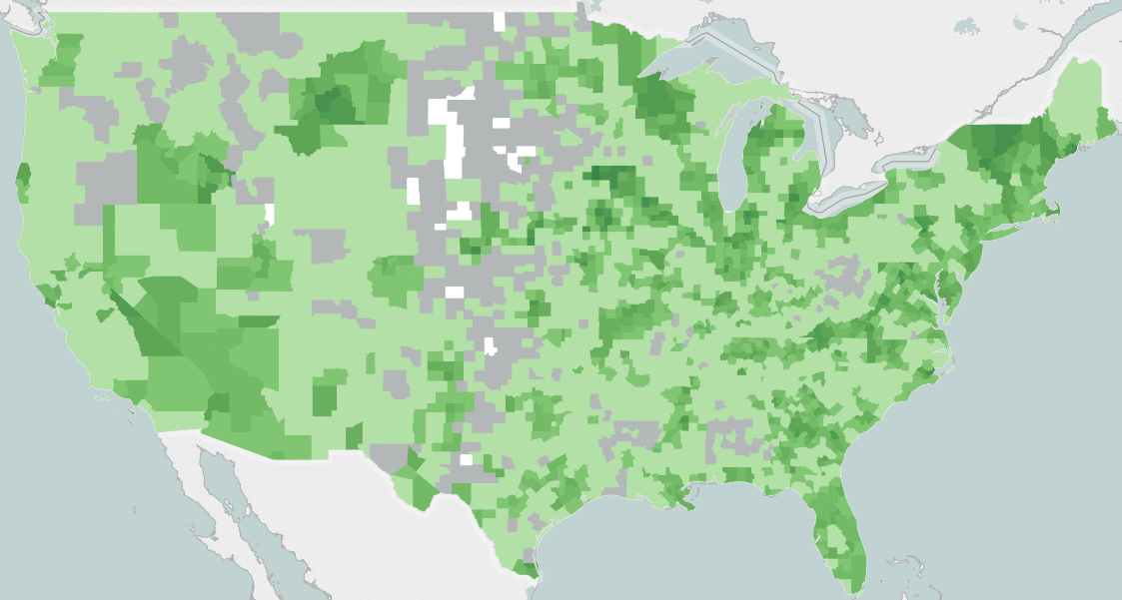
County Exposure to MSSP ACOs, 2014
Darker shades of green represent counties with a greater share of ACO-eligible beneficiaries assigned to an ACO. The shaded county is the area of residence on file for the beneficiary.
Dark gray shading represents counties with fewer than 11 ACO-eligible beneficiaries. Due to our data use agreement, we are unable to provide exposure rates for these counties.
White shading represents counties with no ACO-attributed beneficiaries.
Light gray shading represents counties with fewer than 11 ACO-attributed beneficiaries. Due to our data use agreement, we are unable to provide exposure rates for these counties.
Source: Dobson|DaVanzo analysis of 2014 VRDC RIF data, DUA #28643.

Slide 4
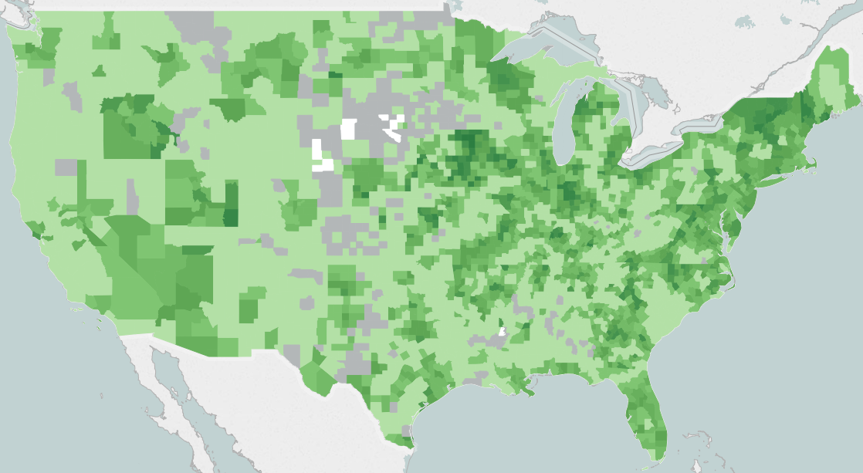
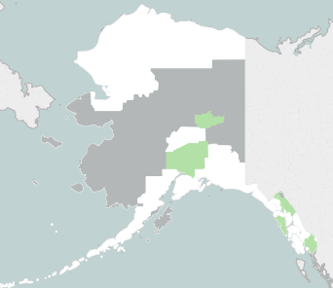
County Exposure to MSSP ACOs, 2015
Darker shades of green represent counties with a greater share of ACO-eligible beneficiaries assigned to an ACO. The shaded county is the area of residence on file for the beneficiary.
Dark gray shading represents counties with fewer than 11 ACO-eligible beneficiaries. Due to our data use agreement, we are unable to provide exposure rates for these counties.
White shading represents counties with no ACO-attributed beneficiaries.
Light gray shading represents counties with fewer than 11 ACO-attributed beneficiaries. Due to our data use agreement, we are unable to provide exposure rates for these counties.
Source: Dobson|DaVanzo analysis of 2015 VRDC RIF data, DUA #28643.

Slide 5
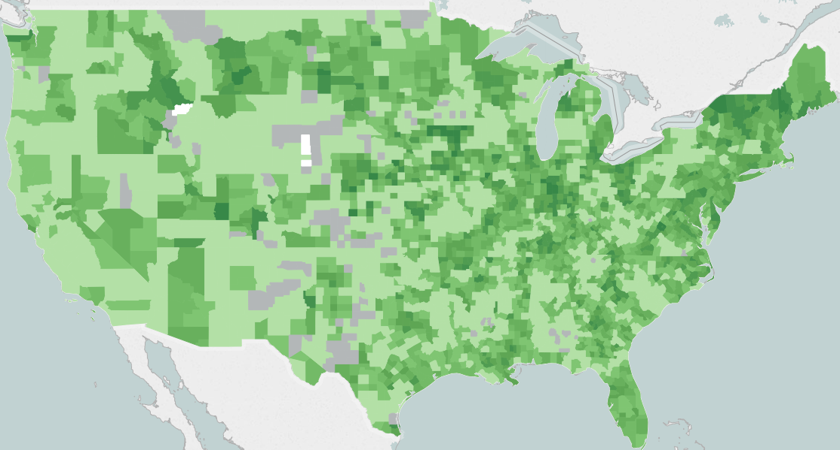
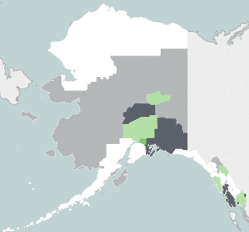
County Exposure to MSSP ACOs, 2016
Darker shades of green represent counties with a greater share of ACO-eligible beneficiaries assigned to an ACO. The shaded county is the area of residence on file for the beneficiary.
Dark gray shading represents counties with fewer than 11 ACO-eligible beneficiaries. Due to our data use agreement, we are unable to provide exposure rates for these counties.
White shading represents counties with no ACO-attributed beneficiaries.
Light gray shading represents counties with fewer than 11 ACO-attributed beneficiaries. Due to our data use agreement, we are unable to provide exposure rates for these counties.
Source: Dobson|DaVanzo analysis of 2016 VRDC RIF data, DUA #28643.

